Slide 1
EE653 Power distribution system modeling, optimization and simulation
ECpE Department
Dr. Zhaoyu Wang
1113 Coover Hall, Ames, IA
wzy@iastate.edu

Slide 2
Modeling Shunt Admittance of Overhead and
Underground Lines
Acknowledgement: The slides are developed based in part on Distribution System Modeling and Analysis, 4th edition, William H. Kersting, CRC Press, 2017

Slide 3
Overview
Conductor Types (materials) & Construction Info (spacings)
Primitive Potential Coefficient Matrix
$$\left[{\hat{P}}_{primitive}\right]$$
Self and Mutual Potential Coefficients
Partition Form
Kron reduction
Phase Potential Coefficient Matrix [P_{abc}]
$$\left[{\hat{P}}_{primitive}\right]=\left[\begin{matrix}\left[{\hat{P}}_{ij}\right] & \left[{\hat{P}}_{in}\right] \\ \left[{\hat{P}}_{nj}\right] & \left[{\hat{P}}_{nn}\right]\end{matrix}\right]$$
Capacitance Matrix [C_{abc}]
Phase Shunt Admittance Matrix [y_{abc}]
ECpE Department

Slide 4
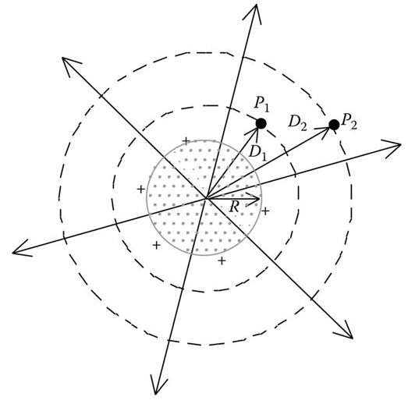
Shunt Admittance of Overhead and Underground Lines
The shunt admittance of a line consists of the conductance and the capacitive susceptance. The conductance is usually ignored because it is very small compared to the capacitive susceptance.
The capacitance of a line is the result of the potential difference between conductors. A charged conductor creates an electric field that emanates outward from the center of the conductor. Lines of equipotential are created that are concentric to the charged conductor. This is illustrated in Fig.1.
Fig.1 Electric field of a charged round conductor
ECpE Department

Slide 5
Shunt Admittance of Overhead and Underground Lines
In Fig.1, a difference of potential between two points (P₁ and P₂) is a result of the electric field of the charged conductor. When the potential difference between the two points is known, then the capacitance between the two points can be computed.
If there are other charged conductors nearby, the potential difference between the two points will be a function of the distance to the other conductors and the charge on each conductor. The principle of superposition is used to compute the total voltage drop between two points and then the resulting capacitance between the points.
The points can be points in space or the surface of two conductors or the surface of a conductor and ground.
ECpE Department

Slide 6
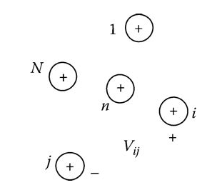
General Voltage Drop Equation
Fig.2 shows an array of N positively charged solid round conductors. Each conductor has a unique uniform charge density of q cb/m.
The voltage drop between conductor i and conductor j as a result of all of the charged conductors is given by
$V_{ij}$=$\frac{1}{2πε} (q_{1}∗\ln{\frac{D_{1j}}{D_{1i}}}+…q_{i}∗\ln{\frac{D_{ij}}{{RD}_{i}}}+…q_{j}∗\ln{\frac{{RD}_{j}}{D_{ij}}}+…q_{N}∗\ln{\frac{D_{Nj}}{D_{Ni}}})$
(1)
Fig.2 Array of round conductors
ECpE Department

Slide 7
General Voltage Drop Equation
$V_{ij}$=$\frac{1}{2πε} (q_{1}∗\ln{\frac{D_{1j}}{D_{1i}}}+…q_{i}∗\ln{\frac{D_{ij}}{{RD}_{i}}}+…q_{j}∗\ln{\frac{{RD}_{j}}{D_{ij}}}+…q_{N}∗\ln{\frac{D_{Nj}}{D_{Ni}}})$
(1)
Equation (1) can be written in a general form as
$V_{ij}$=$\frac{1}{2πε}\sum_{n=1}^{N}{q_{N}∗\ln{\frac{D_{nj}}{D_{ni}}}}$
(2)
where
ε = ε₀ε_{r} is the permittivity of the medium, ε₀ is the permittivity of free space = 8.85 × 10⁻¹² μF/m, ε_{r} is the relative permittivity of the medium
q_{n} is the charge density on conductor n cb/m
D_{ni} is the distance between conductor n and conductor i (ft)
D_{nj} is the distance between conductor n and conductor j (ft)
D_{nn} is the radius (RD_{n}) of conductor n (ft)
ECpE Department

Slide 8
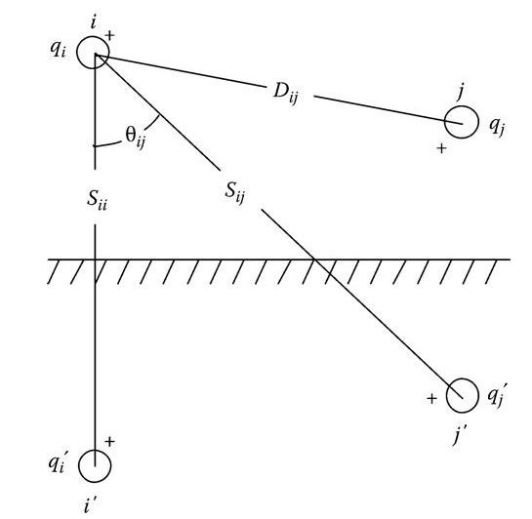
Overhead Lines
The method of conductors and their images is employed in the calculation of the shunt capacitance of overhead lines.
This is the same concept that was used in the general application of Carson's equations.
Figure 3 illustrates the conductors and their images and will be used to develop a general voltage drop equation for overhead lines.
Fig.3 Conductors and images
ECpE Department

Slide 9
Overhead Lines
In Fig.3 it is assumed that
$q_{i}^{′}=−q_{i}$, $q_{j}^{′}=−q_{j}$
(3)
Appling Equation (2) to Figure 5.3,
$V_{ii′}$=$\frac{1}{2πε} (q_{i}∗\ln{\frac{S_{ii}}{{RD}_{i}}}+q_{i}^{′}∗\ln{\frac{{RD}_{i}}{S_{ii}}}+q_{j}∗\ln{\frac{S_{ij}}{D_{ij}}}+q_{j}^{′}∗\ln{\frac{D_{ij}}{S_{ij}}})$
(4)
Fig.3 Conductors and images
ECpE Department

Slide 10
Overhead Lines
$q_{i}^{′}=−q_{i}$, $q_{j}^{′}=−q_{j}$
(3)
$V_{ii′}$=$\frac{1}{2πε} (q_{i}∗\ln{\frac{S_{ii}}{{RD}_{i}}}+q_{i}^{′}∗\ln{\frac{{RD}_{i}}{S_{ii}}}+q_{j}∗\ln{\frac{S_{ij}}{D_{ij}}}+q_{j}^{′}∗\ln{\frac{D_{ij}}{S_{ij}}})$
(4)
Because of the assumptions of Equation (3), Equation (4) can be simplified to
$V_{ii}$=$\frac{1}{2πε} \left(q_{i}∗\ln{\frac{S_{ii}}{{RD}_{i}}}{−q}_{i}∗\ln{\frac{{RD}_{i}}{S_{ii}}}+q_{j}∗\ln{\frac{S_{ij}}{D_{ij}}}{−q}_{j}∗\ln{\frac{D_{ij}}{S_{ij}}}\right)$
=$\frac{1}{2πε} \left(q_{i}∗\ln{\frac{S_{ii}}{{RD}_{i}}}{+q}_{i}∗\ln{\frac{S_{ii}}{{RD}_{i}}}+q_{j}∗\ln{\frac{S_{ij}}{D_{ij}}}{+q}_{j}∗\ln{\frac{S_{ij}}{D_{ij}}}\right)$
=$\frac{1}{2πε} \left({2q}_{i}∗\ln{\frac{S_{ii}}{{RD}_{i}}}+{2q}_{j}∗\ln{\frac{S_{ij}}{D_{ij}}}\right)$
(5)
where
S_{ii} is the distance from conductor i to its image i′ (ft)
S_{ij} is the distance from conductor i to the image of conductor j′ (ft)
D_{ij} is the distance from conductor i to conductor j (ft)
RD_{i} is the radius of conductor i in ft
Fig.3 Conductors and images
ECpE Department

Slide 11
Overhead Lines
$V_{ii′}$=$\frac{1}{2πε} \left({2q}_{i}∗\ln{\frac{S_{ii}}{{RD}_{i}}}+{2q}_{j}∗\ln{\frac{S_{ij}}{D_{ij}}}\right)$
(5)
Equation (5) gives the total voltage drop between conductor i and its image. The voltage drop between conductor i and ground will be one-half of that given in Equation (5):
$V_{ig}$=$\frac{1}{2πε} \left(q_{i}∗\ln{\frac{S_{ii}}{{RD}_{i}}}+q_{j}∗\ln{\frac{S_{ij}}{D_{ij}}}\right)$
(6)
Equation (6) can be written in general form as
$V_{ig}$=${\hat{P}}_{ii}∗q_{i}+{\hat{P}}_{ij}∗q_{j}$
(7)
where ${\hat{P}}_{ii}$ and ${\hat{P}}_{ij}$ are the self- and mutual “potential coefficients.”
For overhead lines the relative permittivity of air is assumed to be 1.0 so that
$ε_{0}$=1.0$×8.85×{10}^{−12} F/m$, $ε_{air}$=1$.4240×{10}^{−2} μF/mile$
(8)
Using the value of permittivity in μF/mile, the self- and mutual potential coefficients are defined as
${\hat{P}}_{ii}=11.17689∗\ln{\frac{S_{ii}}{{RD}_{i}}}$ mile/$μF$
(9)
${\hat{P}}_{ij}=11.17689∗\ln{\frac{S_{ij}}{D_{j}}}$ mile/$μF$
(10)
ECpE Department

Slide 12
Overhead Lines
${\hat{P}}_{ii}=11.17689∗\ln{\frac{S_{ii}}{{RD}_{i}}}$ mile/$μF$
(9)
${\hat{P}}_{ij}=11.17689∗\ln{\frac{S_{ij}}{D_{j}}}$ mile/$μF$
(10)
Note: In applying Equations (9) and (10), the values of RD_{i}, S_{ii}, S_{ij}, and D_{ij} must all be in the same units. For overhead lines the distances between conductors are typically specified in feet while the value of the conductor diameter from a table will typically be in inches. Care must be taken to ensure that the radius in feet is used in applying the two equations.
For an overhead line of ncond conductors, the “primitive potential coefficient matrix” can be constructed. The primitive potential coefficient matrix will be an ncond × ncond matrix. For a four-wire grounded wye line the primitive coefficient matrix will be of the form
$$\left[{\hat{P}}_{primitive}\right]=\left[\begin{aligned}{\hat{P}}_{aa} \\ {\hat{P}}_{ba} \\ {\hat{P}}_{ca} \\ ∙ \\ {\hat{P}}_{na}\end{aligned}\begin{aligned}{\hat{P}}_{ab} \\ {\hat{P}}_{bb} \\ {\hat{P}}_{cb} \\ ∙ \\ {\hat{P}}_{nb}\end{aligned}\begin{aligned}{\hat{P}}_{ac} \\ {\hat{P}}_{bc} \\ {\hat{P}}_{cc} \\ ∙ \\ {\hat{P}}_{nc}\end{aligned}\begin{aligned}∙ \\ ∙ \\ ∙ \\ ∙ \\ ∙\end{aligned}\begin{aligned}{\hat{P}}_{an} \\ {\hat{P}}_{bn} \\ {\hat{P}}_{cn} \\ ∙ \\ {\hat{P}}_{nn}\end{aligned}\right]$$
(11)
ECpE Department

Slide 13
Overhead Lines
$$\left[{\hat{P}}_{primitive}\right]=\left[\begin{aligned}{\hat{P}}_{aa} \\ {\hat{P}}_{ba} \\ {\hat{P}}_{ca} \\ ∙ \\ {\hat{P}}_{na}\end{aligned}\begin{aligned}{\hat{P}}_{ab} \\ {\hat{P}}_{bb} \\ {\hat{P}}_{cb} \\ ∙ \\ {\hat{P}}_{nb}\end{aligned}\begin{aligned}{\hat{P}}_{ac} \\ {\hat{P}}_{bc} \\ {\hat{P}}_{cc} \\ ∙ \\ {\hat{P}}_{nc}\end{aligned}\begin{aligned}∙ \\ ∙ \\ ∙ \\ ∙ \\ ∙\end{aligned}\begin{aligned}{\hat{P}}_{an} \\ {\hat{P}}_{bn} \\ {\hat{P}}_{cn} \\ ∙ \\ {\hat{P}}_{nn}\end{aligned}\right]$$
(11)
The dots (·) in Equation (11) are partitioning the matrix between the third and fourth rows and columns. In partitioned form Equation (11) becomes
$$\left[{\hat{P}}_{primitive}\right]=\left[\begin{matrix}\left[{\hat{P}}_{ij}\right] & \left[{\hat{P}}_{in}\right] \\ \left[{\hat{P}}_{nj}\right] & \left[{\hat{P}}_{nn}\right]\end{matrix}\right]$$
(12)
Because the neutral conductor is grounded, the matrix can be reduced using the “Kron reduction” method to an n-phase × n-phase phase potential coefficient matrix [P_{abc}] given by
[$P_{abc}$]$=\left[{\hat{P}}_{ij}\right]$-$\left[{\hat{P}}_{in}\right]{∗\left[{\hat{P}}_{nn}\right]}^{−1}∗\left[{\hat{P}}_{jn}\right]$
(13)
The inverse of the potential coefficient matrix will give the n-phase × n-phase capacitance matrix [C_{abc}]:
[$C_{abc}$]$={\left[{\hat{P}}_{abc}\right]}^{−1}$
(14)
ECpE Department

Slide 14
Overhead Lines
[$C_{abc}$]$={\left[P_{abc}\right]}^{−1}$
(14)
For a two-phase line the capacitance matrix of Equation (14) will be 2 × 2. A row and a column of zeros must be inserted for the missing phase. For a single-phase line, Equation (14) will result in a single element. Again rows and columns of zero must be inserted for the missing phase. In the case of the single-phase line, the only nonzero term will be that of the phase in use.
Neglecting the shunt conductance, the phase shunt admittance matrix is given by
[$y_{abc}$]$=0+j∗ω$ $∗$[$C_{abc}$] $μS/mile$
(15)
where
$$ω=2∗π∗f=376.9911$$
ECpE Department

Slide 15
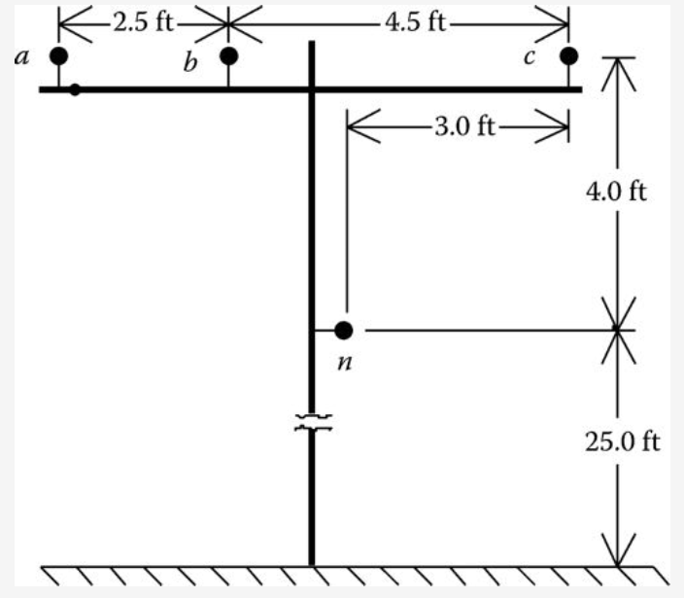
Example 1
Determine the shunt admittance matrix for the overhead line. Assume that the neutral conductor is 25 ft above ground.
The diameters of the phase and neutral conductors from the conductor table (Appendix A) are:
Conductor, 336,400 26/7 ACSR, $d_{c}=0.721 in., {RD}_{c}=0.03004 ft$; 4/0 6/1 ACSR, $d_{c}=0.563 in., {RD}_{c}=0.02346 ft$
Overhead line of Example 4.1
ECpE Department

Slide 16
Example 1
Using the Cartesian coordinated in Example 4.1, the image distance matrix is given by
$$S_{ij}=\left|d_{i}−d_{j}^{∗}\right|$$
Where $d_{j}^{∗}$ is the conjugate of $d_{j}$
For the configuration the distances between conductors and images in matrix form are
$\left[S\right]=\left[\begin{matrix}\begin{aligned}58 \\ 58.0539 \\ 58.4209 \\ 54.1479\end{aligned} & \begin{aligned}58.0539 \\ 58 \\ 58.1743 \\ 54.0208\end{aligned} \begin{aligned}58.4209 \\ 58.1743 \\ 58 \\ 54.0833\end{aligned} & \begin{aligned}54.1479 \\ 54.0208 \\ 54.0833 \\ 50\end{aligned}\end{matrix}\right]$ $ft$
The self-primitive potential coefficient for phase a and the mutual primitive potential coefficient between phases a and b are
${\hat{P}}_{aa}=11.17689∗\ln{\frac{58}{0.03004}=84.5600}$ mile/$μF$
${\hat{P}}_{ab}=11.17689∗\ln{\frac{58.0539}{2.5}}=35.1522$ mile/$μF$
ECpE Department

Slide 17
Example 1
${\hat{P}}_{ii}=11.17689∗\ln{\frac{S_{ii}}{{RD}_{i}}}$ mile/$μF$
(9)
${\hat{P}}_{ij}=11.17689∗\ln{\frac{S_{ij}}{D_{j}}}$ mile/$μF$
(10)
Using Equations (9) and (10), the total primitive potential coefficient matrix is computed to be
$\left[{\hat{P}}_{primitive}\right]=\left[\begin{matrix}\begin{aligned}84.5600 \\ 35.1522 \\ 23.7147 \\ 25.2469\end{aligned} & \begin{aligned}35.1522 \\ 84.5600 \\ 28.6058 \\ 28.3590\end{aligned} \begin{aligned}23.7147 \\ 28.6058 \\ 84.5600 \\ 26.6131\end{aligned} & \begin{aligned}25.2469 \\ 28.3590 \\ 26.6131 \\ 85.6659\end{aligned}\end{matrix}\right]$mile/$μF$
Since the fourth conductor (neutral) is grounded, the Kron reduction method is used to compute the “phase potential coefficient matrix.” Because only one row and one column need to be eliminated, the [${\hat{P}}_{nn}$] term is a single element so that the Kron reduction equation for this case can be modified to
$$P_{ij}={\hat{P}}_{ij}−\frac{{\hat{P}}_{i4}∗{\hat{P}}_{j4}}{{\hat{P}}_{44}}$$
where i = 1, 2, 3 and j = 1, 2, 3.
ECpE Department

Slide 18
Example 1
For example, the value of P_{cb} is computed to be
$P_{cb}={\hat{P}}_{32}−\frac{{\hat{P}}_{34}∗{\hat{P}}_{24}}{{\hat{P}}_{44}}=28.6058−\frac{26.6134∗28.359}{85.6659}$ $=$19.7957
Following the Kron reduction, the phase potential coefficient matrix is
$\left[P_{abc}\right]$=$\left[\begin{matrix}77.1194 & 26.7944 & 15.8714 \\ 26.7944 & 75.1720 & 19.7957 \\ 15.8714 & 19.7957 & 76.2923\end{matrix}\right]$
Invert [P_{abc}] to determine the shunt capacitance matrix:
$\left[C_{abc}\right]$=${[P]}^{−1}$=$\left[\begin{matrix}0.015 & −0.0049 & −0.0019 \\ −0.0049 & 0.0159 & −0.0031 \\ −0.0019 & −0.0031 & 0.0143\end{matrix}\right]$
Multiply [C_{abc}] by the radian frequency to determine the final three-phase shunt admittance matrix:
$\left[y_{abc}\right]$=j*376.9911*$\left[C_{abc}\right]$=$\left[\begin{matrix}j5.6711 & −j1.8362 & −j0.7033 \\ −j1.8362 & j5.9774 & −j1.1690 \\ −j0.7033 & −j1.169 & j5.3911\end{matrix}\right]$ $μS/mile$
ECpE Department

Slide 19
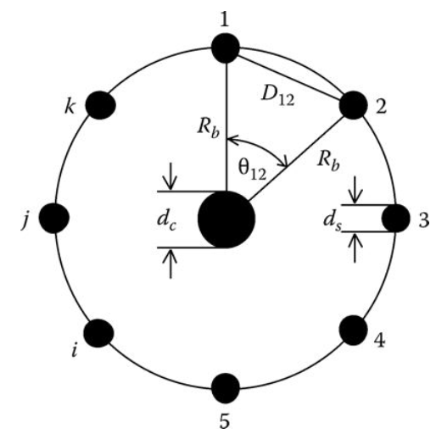
Concentric Neutral Cable Underground Lines
Most underground distribution lines consist of one or more concentric neutral cables. Fig.4 illustrates a basic concentric neutral cable with center conductor being the phase conductor and the concentric neutral strands displaced equally around a circle of radius R_{b}.
Fig.4 Conductors and images
ECpE Department

Slide 20
Concentric Neutral Cable Underground Lines
Referring to Fig.4 the following definitions apply:
R_{b} represents the radius of a circle passing through the centers of the neutral strands.
d_{c} represents the diameter of the phase conductor.
d_{s} represents the diameter of a neutral strand.
k represents the total number of neutral strands.
Fig.4 Conductors and images
ECpE Department

Slide 21
Concentric Neutral Cable Underground Lines
$V_{ij}$=$\frac{1}{2πε}\sum_{n=1}^{N}{q_{N}∗\ln{\frac{D_{nj}}{D_{ni}}}}$
(2)
The concentric neutral strands are grounded so that they are all at the same potential. Because of the stranding, it is assumed that the electric field created by the charge on the phase conductor will be confined to the boundary of the concentric neutral strands. In order to compute the capacitance between the phase conductor and ground, the general voltage drop of Equation (2) will be applied. Since all of the neutral strands are at the same potential, it is necessary to determine only the potential difference between the phase conductor p and strand 1.
$V_{p1}$=$\frac{1}{2πε} (q_{p}∗\ln{\frac{R_{b}}{{RD}_{c}}}+q_{1}∗\ln{\frac{{RD}_{s}}{R_{b}}}+q_{2}∗\ln{\frac{D_{12}}{R_{b}}}+…q_{i}∗\ln{\frac{D_{1i}}{R_{b}}}+…q_{k}∗\ln{\frac{D_{k1}}{R_{b}}})$
where
(16)
$${RD}_{c}=\frac{d_{c}}{2},{RD}_{s}=\frac{d_{s}}{2}$$
It is assumed that each of the neutral strands carries the same charge such that
$$q_{1}=q_{2}=q_{i}=q_{k}=−\frac{q_{p}}{k}$$
(17)
ECpE Department

Slide 22
Concentric Neutral Cable Underground Lines
$V_{p1}$=$\frac{1}{2πε} (q_{p}∗\ln{\frac{R_{b}}{{RD}_{c}}}+q_{1}∗\ln{\frac{{RD}_{s}}{R_{b}}}+q_{2}∗\ln{\frac{D_{12}}{R_{b}}}+…q_{i}∗\ln{\frac{D_{1i}}{R_{b}}}+…q_{k}∗\ln{\frac{D_{k1}}{R_{b}}})$
(16)
Equation (16) can be simplified to
$V_{p1}$=$\frac{1}{2πε} \left[q_{p}∗\ln{\frac{R_{b}}{{RD}_{c}}}−\frac{q_{p}}{k}\left(\ln{\frac{{RD}_{s}}{R_{b}}}+\ln{\frac{D_{12}}{R_{b}}}+…+\ln{\frac{D_{1i}}{R_{b}}}+…+\ln{\frac{D_{k1}}{R_{b}}}\right)\right]$
=$\frac{q_{p}}{2πε} \left[\ln{\frac{R_{b}}{{RD}_{c}}}−\frac{1}{k}\left(\ln{\frac{{RD}_{s}∗D_{12}∗D_{1i}…D_{1k}}{R_{b}^{k}}}\right)\right]$
(18)
ECpE Department

Slide 23
Concentric Neutral Cable Underground Lines
The numerator of the second ln term in Equation (18) needs to be expanded. The numerator represents the product of the radius and the distances between strand i and all of the other strands. Referring to Fig.4, the following relations apply:
$$θ_{12}=\frac{2π}{k}$$
$$θ_{13}=2θ_{12}=\frac{4π}{k}$$
In general, the angle between strand #1 and any other strand #i is given by
$$θ_{1i}=(i−1)θ_{12}=\frac{\left(i−1\right)∗2π}{k}$$
Fig.4 Conductors and images
ECpE Department

Slide 24
Concentric Neutral Cable Underground Lines
The distances between the various strands are given by
$$D_{12}=2∗R_{b}∗\sin{(\frac{θ_{12}}{2})}=2∗R_{b}∗\sin{(\frac{π}{k})}$$
(20)
$$D_{13}=2∗R_{b}∗\sin{(\frac{θ_{13}}{2})}=2∗R_{b}∗\sin{(\frac{2π}{k})}$$
The distance between strand 1 and any other strand i is given by
$$D_{1i}=2∗R_{b}∗\sin{(\frac{θ_{1i}}{2})}=2∗R_{b}∗\sin{(\frac{\left(i−1\right)∗π}{k})}$$
(21)
Equation (21) can be used to expand the numerator of the second log term of Equation (18):
$${{RD}_{s}∗D}_{12}…D_{1i}…D_{1k}$$
$$={RD}_{s}∗R_{b}^{k−1}[2\sin\left(\frac{π}{k}\right)∗2\sin\left(\frac{2π}{k}\right)…2\sin{(\frac{(i−1)π}{k})}…2\sin{(\frac{(k−1) }{k})}]$$
(22)
ECpE Department

Slide 25
Concentric Neutral Cable Underground Lines
$${{RD}_{s}∗D}_{12}…D_{1i}…D_{1k}$$
$$={RD}_{s}∗R_{b}^{k−1}[2\sin\left(\frac{π}{k}\right)∗2\sin\left(\frac{2π}{k}\right)…2\sin{(\frac{(i−1)π}{k})}…2\sin{(\frac{(k−1) }{k})}]$$
(22)
$$\left[V_{LG}\right]=\left[P\right]∗[q]$$
(23)
The distance between strand 1 and any other strand i is given by
$$D_{1i}=2∗R_{b}∗\sin{(\frac{θ_{1i}}{2})}=2∗R_{b}∗\sin{(\frac{\left(i−1\right)∗π}{k})}$$
(21)
Equation (21) can be used to expand the numerator of the second log term of Equation (18):
$${{RD}_{s}∗D}_{12}…D_{1i}…D_{1k}$$
$$={RD}_{s}∗R_{b}^{k−1}[2\sin\left(\frac{π}{k}\right)∗2\sin\left(\frac{2π}{k}\right)…2\sin{(\frac{(i−1)π}{k})}…2\sin{(\frac{(k−1) }{k})}]$$
(22)
ECpE Department

Slide 26
Concentric Neutral Cable Underground Lines
$V_{p1}$=$\frac{q_{p}}{2πε} \left[\ln{\frac{R_{b}}{{RD}_{c}}}−\frac{1}{k}\left(\ln{\frac{k∗{RD}_{s}∗R_{b}^{k−1}}{R_{b}^{k}}}\right)\right]\text{=}\frac{q_{p}}{2πε} \left[\ln{\frac{R_{b}}{{RD}_{c}}}−\frac{1}{k}\left(\ln{\frac{k∗{RD}_{s}}{R_{b}}}\right)\right]$
(24)
Since the neutral strands are all grounded, Equation (24) gives the voltage drop between the phase conductor and ground. Therefore, the capacitance from phase to ground for a concentric neutral cable is given by
$C_{pg}$=$\frac{q_{p}}{V_{p1}}=\frac{2πε}{\ln\left({R_{b}}/{{RD}_{c}}\right)−(1/k)\ln{(k∗{{RD}_{s}}/{R_{b}})}}$
(25)
where
ε = ε₀ε_{r} is the permittivity of the medium
ε₀ is the permittivity of free space = 0.01420 μF/mile
ε_{r} is the relative permittivity of the medium
ECpE Department

Slide 27
Concentric Neutral Cable Underground Lines
The electric field of a cable is confined to the insulation material. Various types of insulation material are used, and each will have a range of values for the relative permittivity. Table.1 gives the range of values of relative permittivity for four common insulation materials.
Table.1 Typical Values of Relative Permittivity ($ε_{r}$)
Material | Range of Value of Relative Permittivity
Polyvinyl chloride (PVC) | 3.4-8.0
Ethylene-propylene rubber (EPR) | 2.5-3.5
Polyethylene (PE) | 2.5-2.6
Cross-linked polyethylene (XLPE) | 2.3-6.0
ECpE Department

Slide 28
Concentric Neutral Cable Underground Lines
Cross-linked polyethylene is a very popular insulation material. If the minimum value of relative permittivity is assumed as 2.3, the equation for the shunt admittance of the concentric neutral cable is given by
$$y_{ag}=0+j\frac{77.3619}{\ln\left({R_{b}}/{{RD}_{c}}\right)−(1/k)\ln{(k∗{{RD}_{s}}/{R_{b}})}} μS/mile$$
(26)
ECpE Department

Slide 29
Example 3
Determine the three-phase shunt admittance matrix for the concentric neutral line.
$$R_{b}=R=0.0511 ft=0.631 in$$
Diameter of the 250,000 AA phase conductor = 0.567 in. Therefore,
$${RD}_{c}=\frac{0.567}{2}=0.2835 in$$
Diameter of the #14 CU concentric neutral strand = 0.0641 in. Therefore,
$${RD}_{s}=\frac{0.0641}{2}=0.03205 in$$
ECpE Department

Slide 30
Example 3
Substitute into (26)
$$y_{ag}=j\frac{77.3619}{\ln\left({R_{b}}/{{RD}_{c}}\right)−(1/k)\ln{(k∗{{RD}_{s}}/{R_{b}})}}$$
(26)
$$y_{ag}=j\frac{77.3619}{\ln\left({0.6132}/{0.2835}\right)−(1/{13})\ln{(13∗{0.03205}/{0.6132})}}=j96.6098 μS/mile$$
The phase admittance for this three-phase underground line is
$\left[y_{abc}\right]$=$\left[\begin{matrix}j96.6098 & 0 & 0 \\ 0 & j96.6098 & 0 \\ 0 & 0 & j96.6098\end{matrix}\right]$ $μS/mile$
ECpE Department

Slide 31
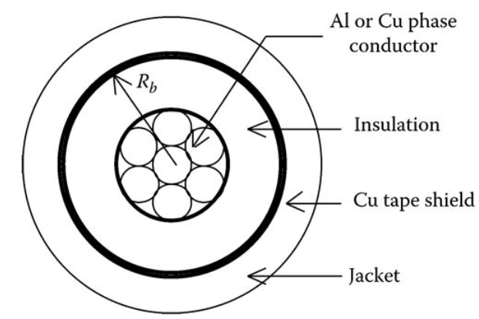
Tape-Shielded Cable Underground Lines
A tape-shielded cable is shown in Figure 5. Referring to Figure 5 R_{b} is the radius of a circle passing through the center of the tape shield. As with the concentric neutral cable, the electric field is confined to the insulation so that the relative permittivity of Table 1 will apply.
Table 1 Typical Values of Relative Permittivity ($ε_{r}$)
Material | Range of Value of Relative Permittivity
Polyvinyl chloride (PVC) | 3.4-8.0
Ethylene-propylene rubber (EPR) | 2.5-3.5
Polyethylene (PE) | 2.5-2.6
Cross-linked polyethylene (XLPE) | 2.3-6.0
Fig.5 Tape-shielded conductor
ECpE Department

Slide 32
Tape-Shielded Cable Underground Lines
$V_{p1}$=$\frac{1}{2πε} \left[q_{p}∗\ln{\frac{R_{b}}{{RD}_{c}}}−\frac{q_{p}}{k}\left(\ln{\frac{{RD}_{s}}{R_{b}}}+\ln{\frac{D_{12}}{R_{b}}}+…+\ln{\frac{D_{1i}}{R_{b}}}+…+\ln{\frac{D_{k1}}{R_{b}}}\right)\right]$
=$\frac{q_{p}}{2πε} \left[\ln{\frac{R_{b}}{{RD}_{c}}}−\frac{1}{k}\left(\ln{\frac{{RD}_{s}∗D_{12}∗D_{1i}…D_{1k}}{R_{b}^{k}}}\right)\right]$
(18)
The tape-shielded conductor can be visualized as a concentric neutral cable where the number of strands k has become infinite. When k in Equation (18) approaches infinity, the second term in the denominator approaches zero. Therefore, the equation for the shunt admittance of a tape-shielded conductor becomes
$$y_{ag}=0+j\frac{77.3619}{\ln\left({R_{b}}/{{RD}_{c}}\right)} μS/mile$$
(27)
ECpE Department

Slide 33
Example 4
Determine the shunt admittance of the single-phase tape-shielded cable. Outside diameter of the tape shield is 0.88 in. The thickness of the tape shield (T) is 5 mil. The radius of a circle passing through the center of the tape shield is given by
$$T=\frac{5}{1000}=0.005$$
$R_{b}=\frac{d_{s}−T}{2}=\frac{0.88−0.005}{2}=0.4375$ in
The diameter of the 1/0 AA phase conductor is 0.368 in. Therefore,
${RD}_{c}=\frac{d_{p}}{2}=\frac{0.368}{2}=0.1840$ in
Substitute into Equation (27):
$$y_{ag}=j\frac{77.3619}{\ln\left({R_{b}}/{{RD}_{c}}\right)}=j\frac{77.3619}{\ln\left({0.4375}/{0.184}\right)}=j89.3179 μS/mile$$
ECpE Department

Slide 34
Example 5.4
The phase admittance for this three-phase underground line is
$\left[y_{abc}\right]$=$\left[\begin{matrix}0 & 0 & 0 \\ 0 & j89.3179 & 0 \\ 0 & 0 & 0\end{matrix}\right]$ $μS/mile$
ECpE Department

Slide 35
Sequence Admittance
The sequence admittances of a three-phase line can be determined in much the same manner as the sequence impedances were determined. Assume that the 3 × 3 admittance matrix is given in S/mile. Then the three-phase capacitance currents as a function of the line-to-ground voltages are given by
$\left[\begin{aligned}\begin{aligned}{Icap}_{a} \\ {Icap}_{b}\end{aligned} \\ {Icap}_{c}\end{aligned}\right]$=$\left[\begin{matrix}y_{aa} & y_{ab} & y_{ac} \\ y_{ba} & y_{bb} & y_{bc} \\ y_{ca} & y_{cb} & y_{cc}\end{matrix}\right]$ $\left[\begin{aligned}\begin{aligned}V_{ag} \\ V_{bg}\end{aligned} \\ V_{cg}\end{aligned}\right]$
(28)
(29)
$\left[{Icap}_{abc}\right]$=$\left[y_{abc}\right]\left[{VLG}_{abc}\right]$
Applying the symmetrical component transformations
$\left[{Icap}_{012}\right]$=${[A_{S}]}^{−1}\left[{Icap}_{abc}\right]\text{=}{[A_{S}]}^{−1}\left[y_{abc}\right]\left[A_{s}\right]\left[{VLG}_{012}\right]$
(30)
ECpE Department

Slide 36
Sequence Admittance
$\left[{Icap}_{012}\right]$=${[A_{S}]}^{−1}\left[{Icap}_{abc}\right]\text{=}{[A_{S}]}^{−1}\left[y_{abc}\right]\left[A_{s}\right]\left[{VLG}_{012}\right]$
(30)
From Equation (30), the sequence admittance matrix is given by
${\left[y_{012}\right]=[A_{S}]}^{−1}\left[y_{abc}\right]\left[A_{s}\right]$=$\left[\begin{matrix}y_{00} & y_{01} & y_{02} \\ y_{10} & y_{11} & y_{12} \\ y_{20} & y_{21} & y_{22}\end{matrix}\right]$
(31)
For a three-phase overhead line with unsymmetrical spacing, the sequence admittance matrix will be full. That is, the off-diagonal terms will be nonzero. However, a three-phase underground line with three identical cables will only have the diagonal terms since there is no “mutual capacitance” between phases. In fact, the sequence admittances will be exactly the same as the phase admittances.
ECpE Department

Slide 37
Thank You!
ECpE Department

